Slide 1
Phase 1
Foxtrot
Claire Badger
Brennan Garland
Mark Demore

Slide 2
High Level Overview of DD
Steps taken by group to accomplish deliverable:
2 group sessions for planning and creating UML diagram
Agree upon overall framework
Individual modifications made as needed with group’s approval
Issues: Unsure of requirements
Solution: build UML based on what we know, expecting modifications in the future

Slide 3
Design Decisions
Justify your Software Quality Attributes
Not many requirements given for the problem design
UML diagram is fairly simple and straightforward
Scalability was a priority for software quality attributes
Pros / Cons of decisions
Pro: Will only have to scale up the design when given more requirements, hopefully won’t have to go back and change anything
Con: UML diagram will need more frequent updates as design details are needed
What Patterns did your group employ? Why?
Interface for missiles since attributes and methods of a missile are the same, but implementation differs
Singleton pattern most useful for launcher/radar, since those two classes are separate but will still talk to each other

Slide 4
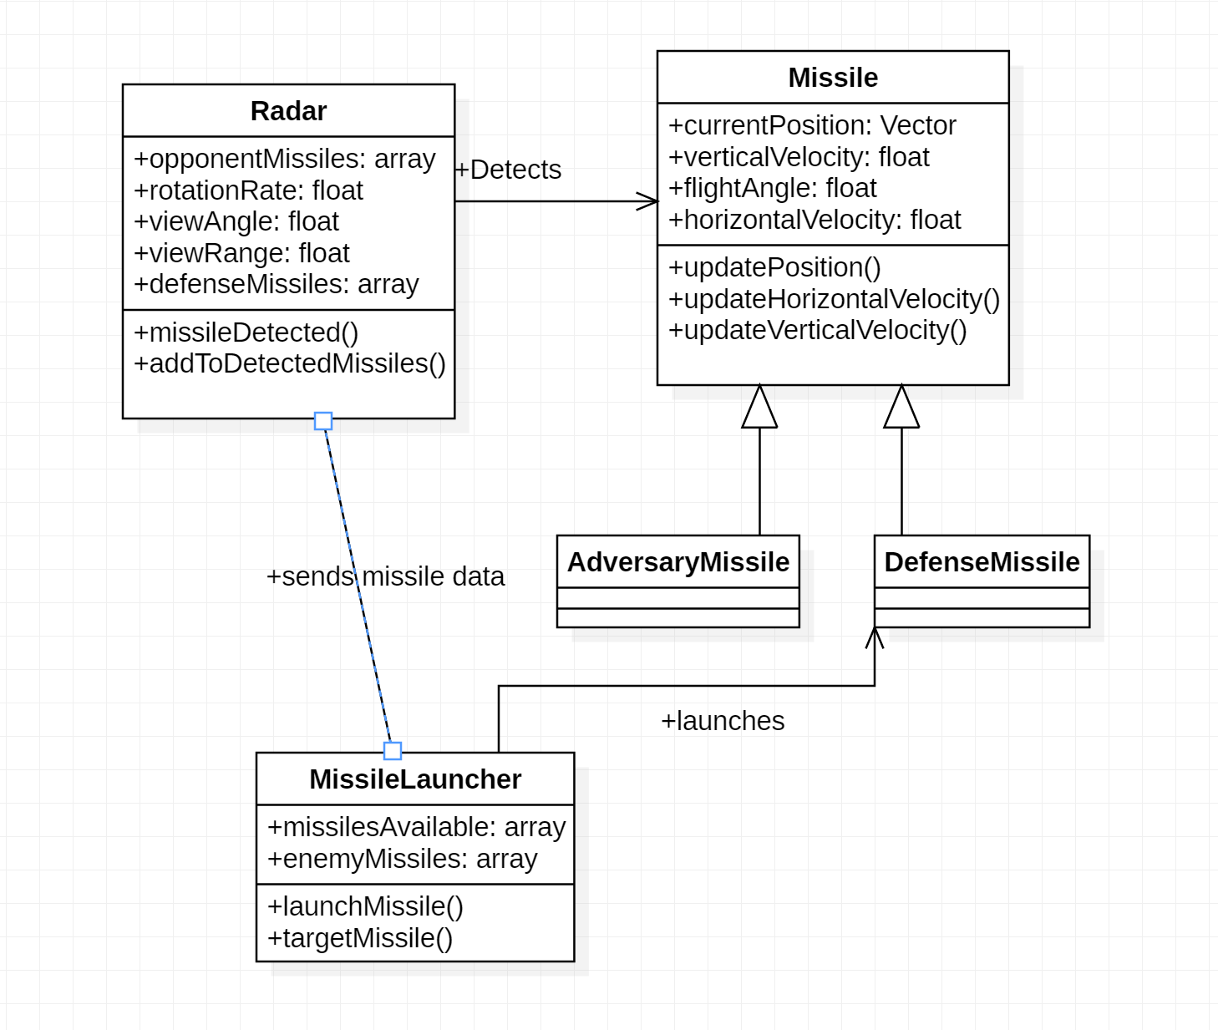
UML Diagrams

Slide 5
Team Hours and Morale
Work was done together, so all hours/morale/time sinks were the same
Lt Demore (2hrs)
2 hrs planning and creating UML/discussion with group
Biggest Time sinks: Referencing UML notation/discussing interpretations of defense system
Current Morale Status: High
Lt Garland
Same as above
Lt Badger
Same as above, plus powerpoint creation

